Slide 1


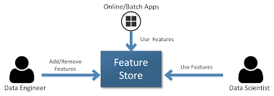
Product Research on Feature Store
Buddhadeb Mondal
buddhadeb33@gmail.com
+91 7501385296

Slide 2
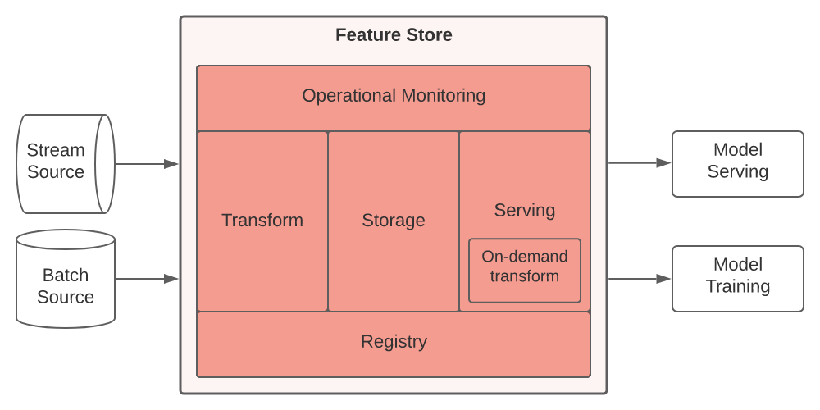
What is Feature Store?
Feature store is a centralized place for creating , managing and searching for features used in machine learning pipelines.

Slide 3
The problems suppose to be solved by feature store
Robust data transformation and real time feature engineering
Write features once
Monitoring and drift detection
Better collaboration
Catalog selection
Smooth model deployment in production

Slide 4
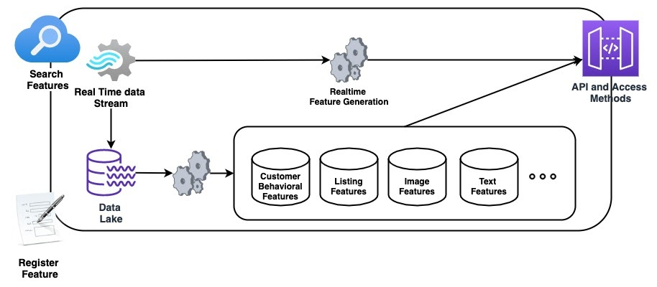
What are building blocks of feature Store?

Slide 5
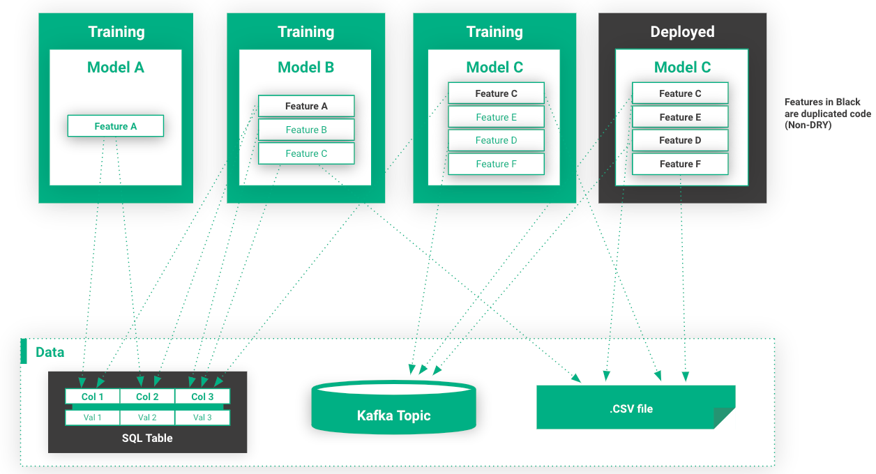
Life Before the Feature Store

Slide 6
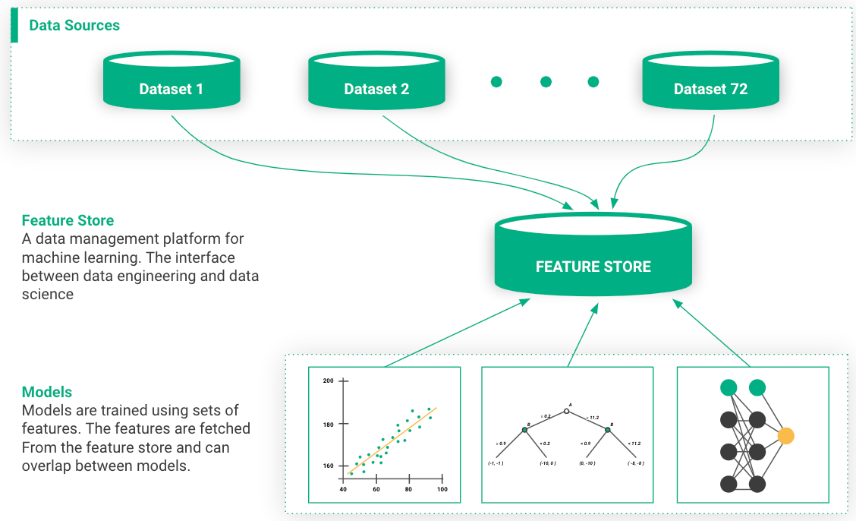
A machine learning Infrastructure with a feature store

Slide 7
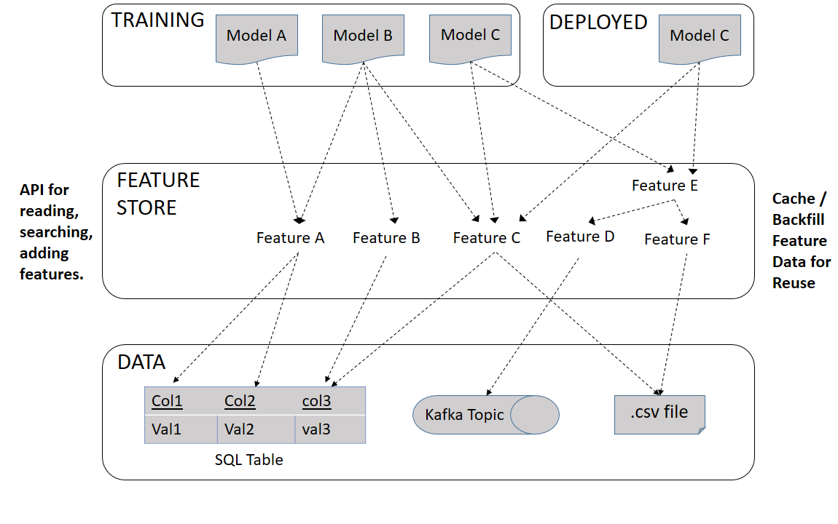
Process flow block diagram for feature Store

Slide 8
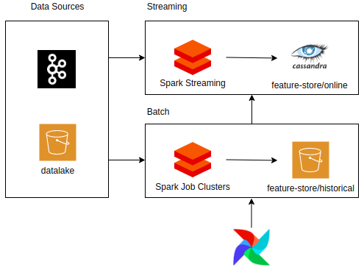
Features & Capabilities of Feature store
Faster development
Smooth model deployment in production
Increased model accuracy
Better collaboration
Track lineage and address regulatory compliance
Feature store and MLOps

Slide 9
Conclusion
Some of the largest tech companies that deal extensively with AI have built their own feature stores (Uber, Twitter, Google, Netflix ,Facebook, Airbnb, etc.). This is a good indication to the rest of the industry of how important it is to use a feature store as a part of an efficient ML pipeline. Given the growing number of AI projects and the complexities associated with bringing these projects to production, the industry needs a way to standardize and automate the core of feature engineering. Therefore, it is fair to assume that the feature store is positioned to be a first level citizen of any machine learning pipeline.

Slide 10

Bibliography
https://www.logicalclocks.com/blog/feature-store-the-missing-data-layer-in-ml-pipelines
https://github.com/umer7/Applied-Text-Mining-in-Python/blob/master/Assignment%2B4.ipynb
https://laptrinhx.com/introducing-feast-1795152965/
https://towardsdatascience.com/what-are-feature-stores-and-why-are-they-critical-for-scaling-data-science-3f9156f7ab4

Slide 11
THANK YOU !!!

